Slide 1
SQL PROJECT
CUSTOMERS
INSIGHTS
Cab Booking System
DRIVERS
METRICS
Analyzing bookings, customer behavior, driver performance and cab operations using MySQL
REVENUE
ANALYSIS
RELATIONAL DATABASE ANALYSIS
Tools: • MySQL • SQL Queries • Joins • Aggregations • Subqueries
Prepared by: Priyanka Asalekar

Slide 2
Project Overview & Objectives
A relational database project focused on cab booking operations and business questions.
The Cab Booking System database organizes booking, customer, cab, driver, trip and feedback information. SQL queries combine related tables to summarize completed bookings, cancellation behavior, driver performance, revenue and operational efficiency.
OBJECTIVES
• Identify frequent customers and booking cancellation patterns.
• Evaluate driver ratings, trip distances and cancelled bookings.
• Analyze completed-trip revenue, routes and cab-type performance.
• Review waiting times, trip-length revenue and weekday/weekend bookings.
CAB BOOKING SYSTEM • 02

Slide 3
Tools & Database Structure
SQL objects and techniques used in the uploaded script.
TOOLS & TECHNOLOGY
DATABASE TABLES
• MySQL Workbench — SQL editor and query execution
booking_details
driver_details
• MySQL — relational database and schema
cab_details
feedback_details
• SELECT, WHERE, GROUP BY, ORDER BY and HAVING
customer_details
trip_details
• JOINs across related tables
• CASE, aggregate functions, date functions and subqueries
CAB BOOKING SYSTEM • 03

Slide 4
Functionality & Approach
How the SQL queries address operational and business questions.
Customer & booking analysis
Completed booking counts, cancellation percentages, busiest booking days and customers above average completed-trip spending.
Driver performance
Average feedback ratings over the past three months, top drivers by distance, and driver cancellation percentages.
Completed-booking revenue for six months, route frequency, pickup waiting time, trip-length revenue and Sedan vs SUV revenue.
Revenue & operations
Weekday vs weekend bookings, drivers above average trip counts, customers with no cancellations and customers inactive for 30 days.
Comparative analysis
CAB BOOKING SYSTEM • 04

Slide 5
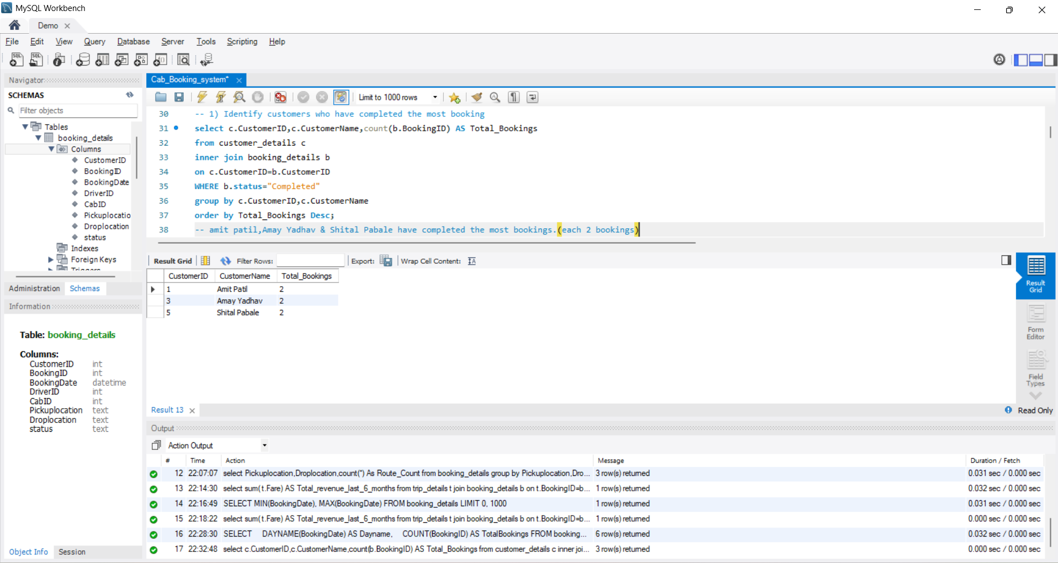
Project Evidence
CAB BOOKING SYSTEM • 05

Slide 6
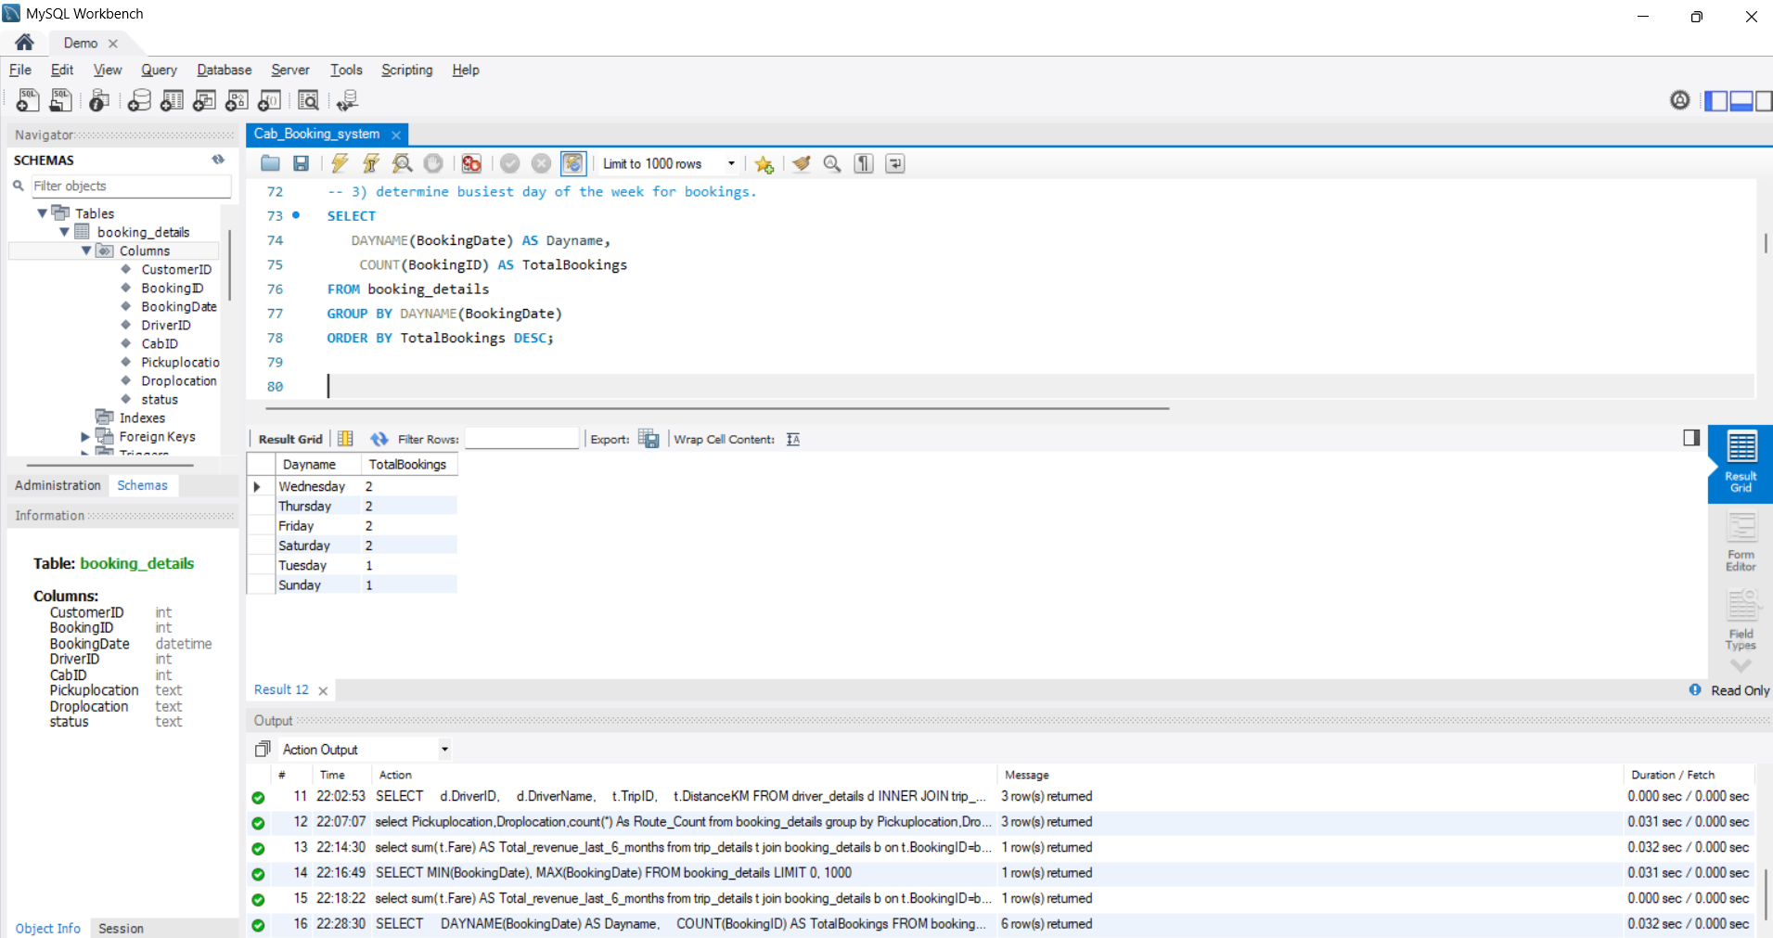
Project Evidence
CAB BOOKING SYSTEM • 06

Slide 7
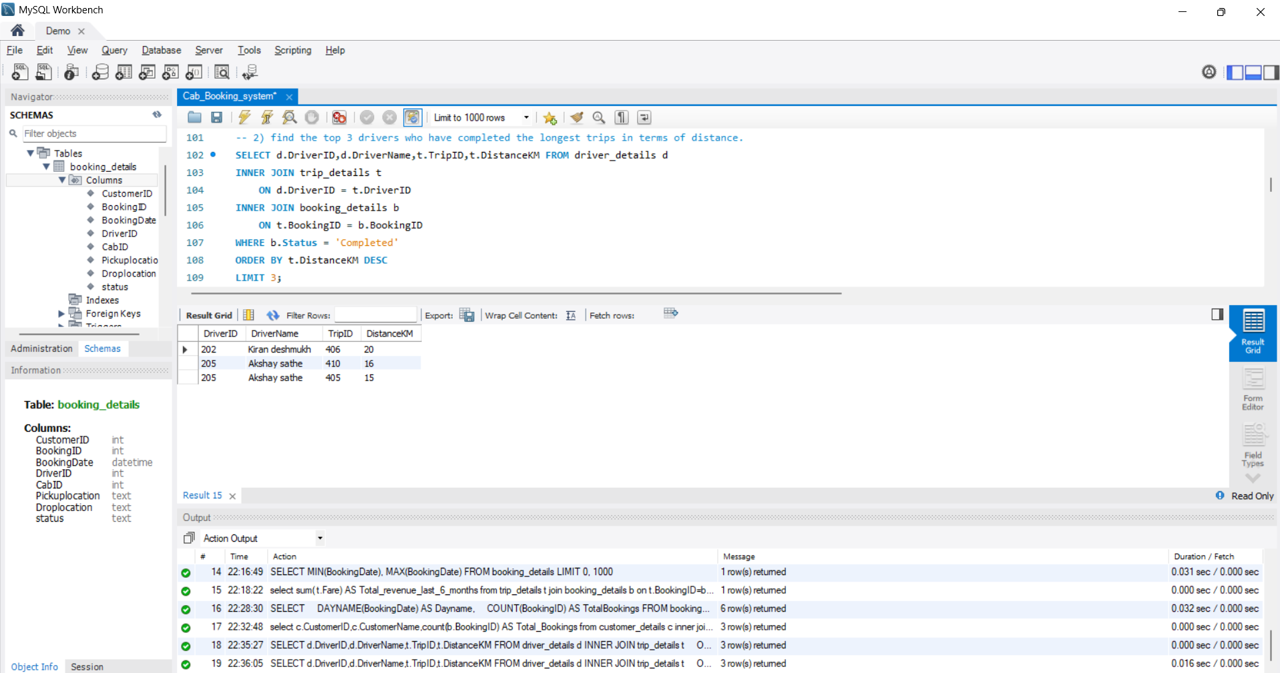
Project Evidence
CAB BOOKING SYSTEM • 07

Slide 8
Conclusion
Summary of the SQL analysis and skills demonstrated.
This project uses a relational database and SQL queries to examine customer booking behavior, driver performance, revenue patterns and operational efficiency. The results can help a cab service identify busy periods, review cancellations and compare trip and cab performance.
KEY LEARNING AREAS
• Joining multiple relational tables
• Aggregating and grouping business data
• Using CASE expressions, date functions and subqueries
• Translating business questions into SQL analysis
CAB BOOKING SYSTEM • 08

